Slide 1


Open GL ES 2.0
Hoang Manh Hung
hung.hoangmanh2@gameloft.com

Slide 2
I. Intro
II. Rendering Pipeline
III. Learn by Example
IV. Conclusion
V. Extras: Shader effects
Agenda

Slide 3
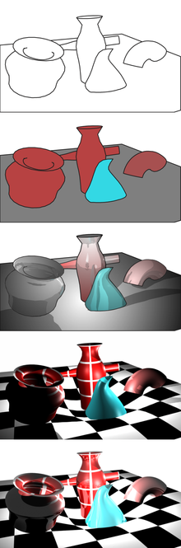


Intro
Notes:
OpenGL is a API to render graphics

Slide 4




Intro

Slide 5
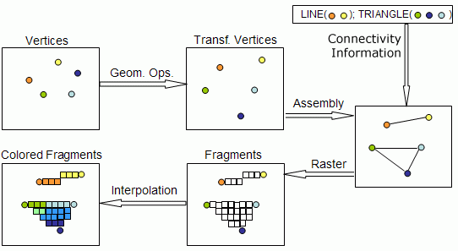
Rendering Pipeline

Slide 6
Understanding shader
Uniforms
Textures
Varying 0
Varying 1
Varying 2
Varying 3
Varying 6
Varying 4
Varying 5
Varying 7
Attribute 0
Attribute 1
Attribute 2
Attribute 3
Attribute 6
Attribute 4
Attribute 5
Attribute 7
Vertex Shader
Uniforms
Textures
Varying 0
Varying 1
Varying 2
Varying 3
Varying 6
Varying 4
Varying 5
Varying 7
Fragment Shader
gl_Position
gl_FragColor

Slide 7
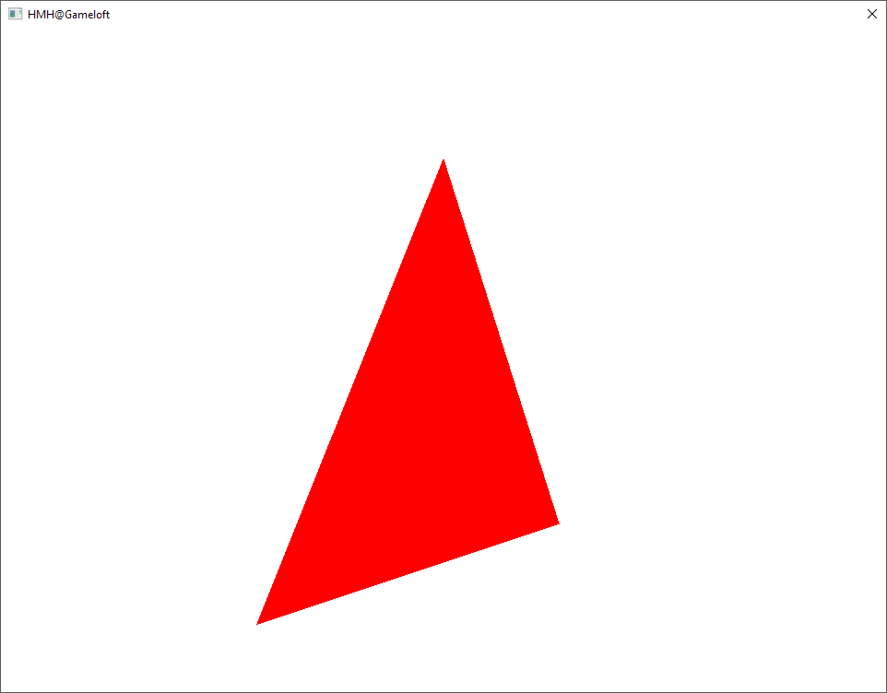
Learn by Example
Notes:
Go through game development process under PRG’s view

Slide 8

Learn by Example
Vertex
* WVP
GL_TRIANGLES
Vertex Shader
Rasterization
Interpolation
Fragment shader

Slide 9
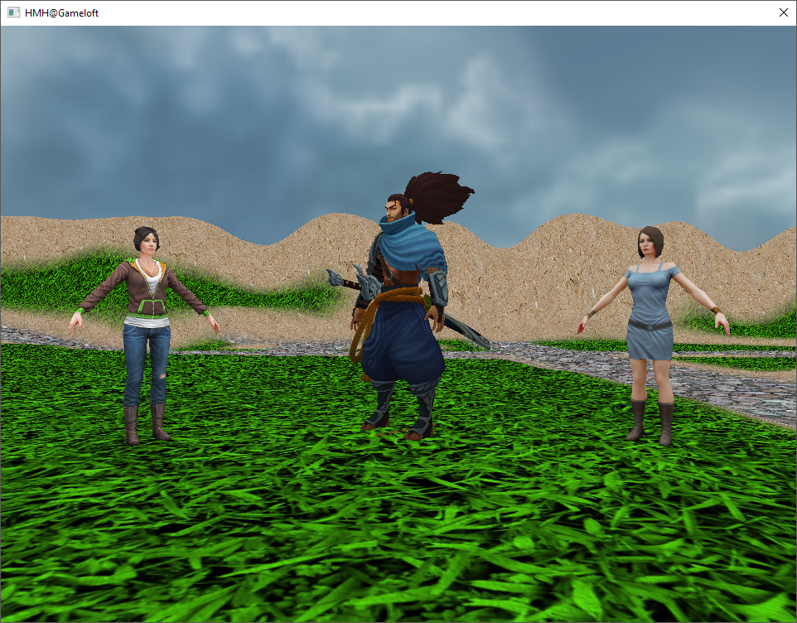
Demo

Slide 10
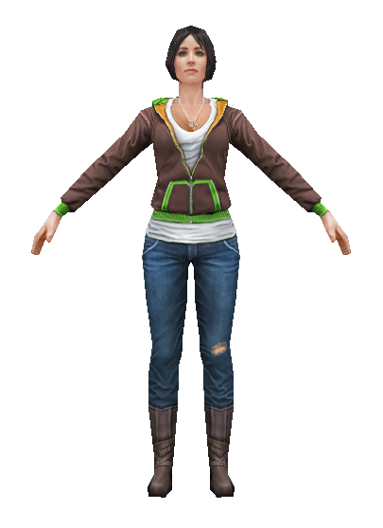
Getting started
Live code:
Draw an object

Slide 11
Conclusion
What we need to draw an object?
1
Shaders
Uniforms
Uniforms
Vertex Shader
Fragment Shader
Attributes
Varyings
gl_Position
gl_FragColor
Notes:
What we need to draw an object:
1. Shaders:
Vertex shader
Input: attributes, uniforms
Output: gl_Position, varyings
Fragment shader
Input: uniforms, varyings
Output: gl_FragColor

Slide 12
Conclusion
What we need to draw an object?
2
Data
RAM
VRAM (GPU)
Vertex Buffer Object
Vertices
Model files
Indices
Index Buffer Object
Notes:
What we need to draw an object:
2. Data: vertex/index, read from model file, store in buffers on GPU

Slide 13

Conclusion
What we need to draw an object?
3
Draw commands
Program 0
Program 1
VBO 1
VBO 2
IBO 1
IBO 2
Commands
VRAM
Use program 0
Use vertices in VBO 2
Use indices in IBO 2
...
Draw using GL_TRIANGLES
GPU
Notes:
What we need to draw an object:
3. Draw commands
Which program?
Which VBO?
Which IBO?

Slide 14
Conclusion
What we need to draw an object?
4
Extra things
Transformation matrix: WVP matrix
Textures
Shader states: GL_DEPTH_TEST, GL_BLEND, ...

Slide 15
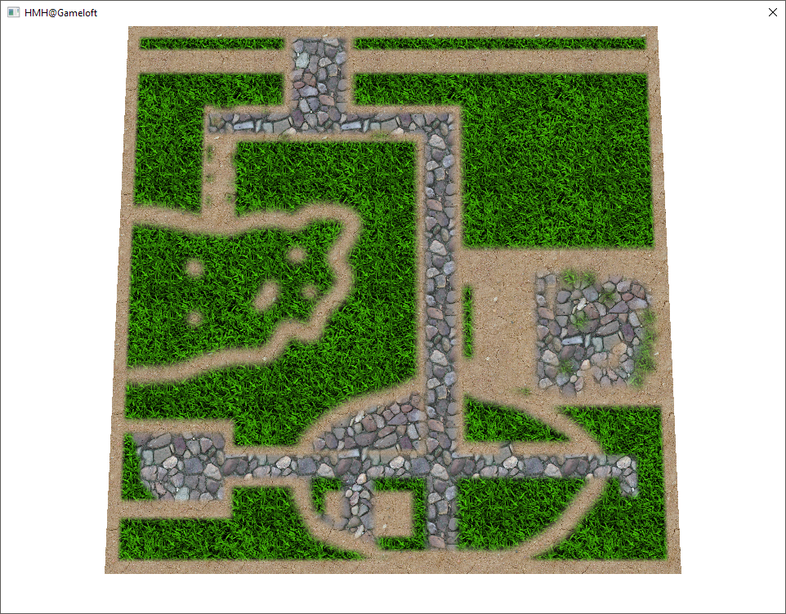
Extras: Shader effects
Multi-texturing

Slide 16
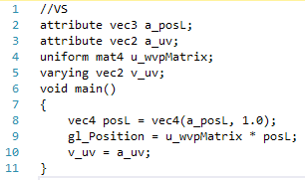
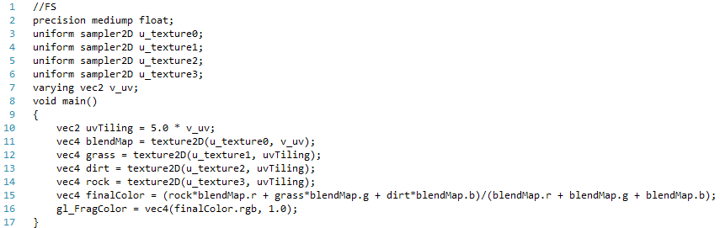
Extras: Shader effects
Multi-texturing

Slide 17
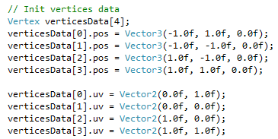
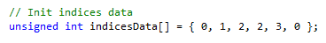
Extras: Shader effects
Multi-texturing

Slide 18
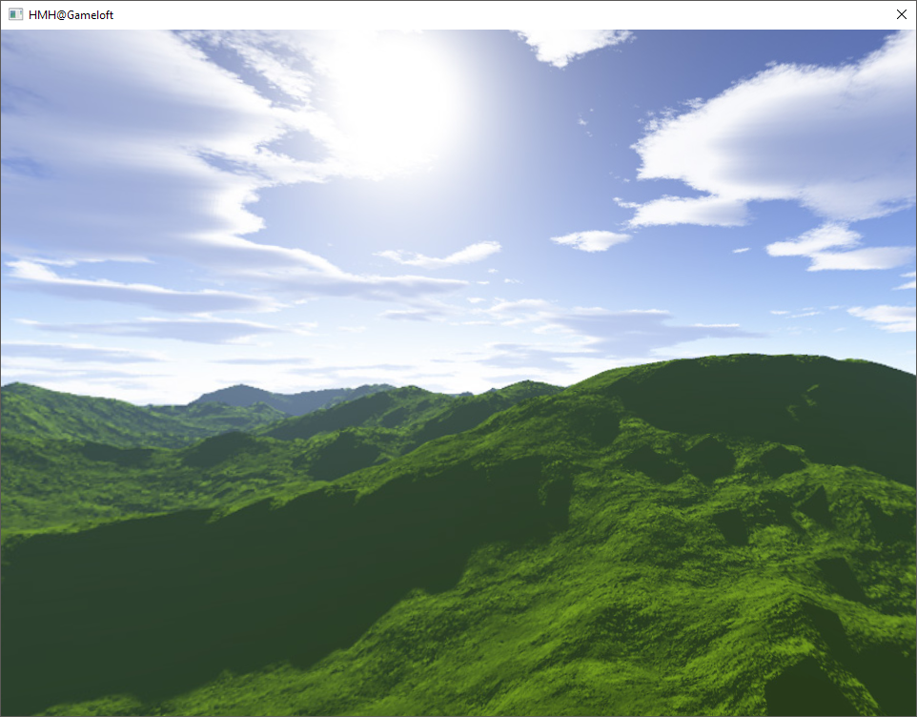
Extras: Shader effects
Texture cube map

Slide 19
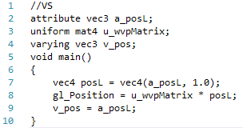
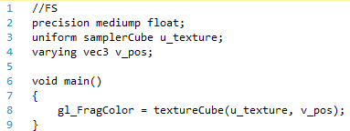
Extras: Shader effects
Texture cube map

Slide 20
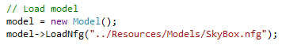
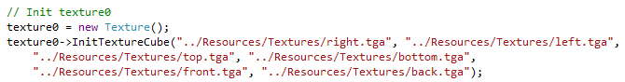
Extras: Shader effects
Texture cube map
Init

Slide 21
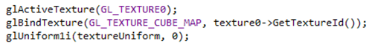
Extras: Shader effects
Texture cube map
Draw

Slide 22
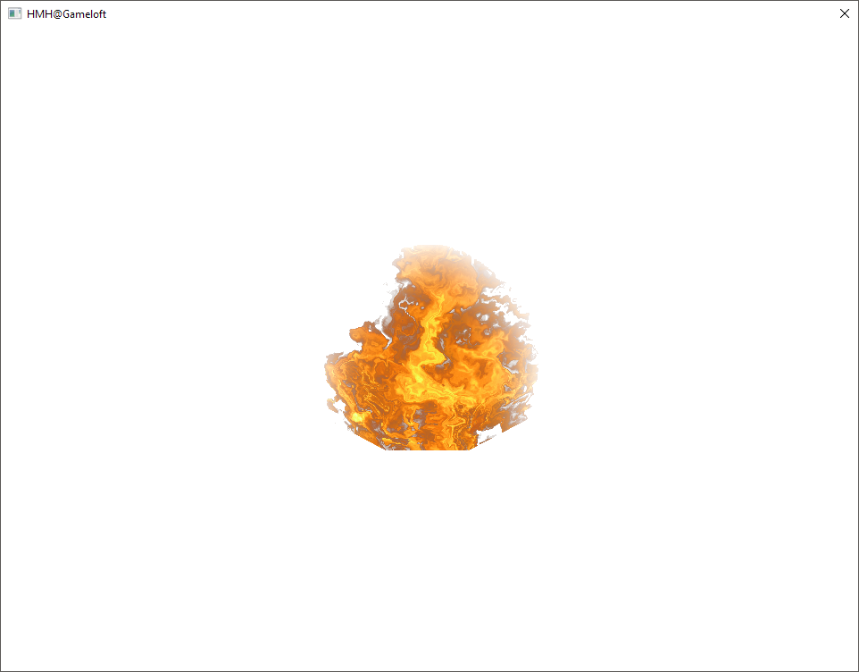
Extras: Shader effects
uv displaement

Slide 23
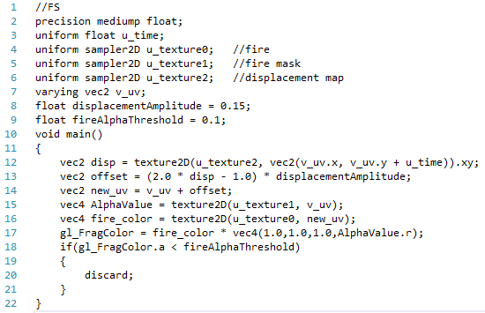
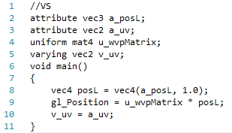
Extras: Shader effects
uv displaement

Slide 24
Extras: Shader effects
uv displaement
Init
Model: fire.nfg
Textures: fire3.tga, fire_mask.tga, DisplacementMap.tga

Slide 25
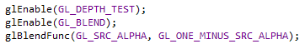
Extras: Shader effects
uv displaement
Update
Draw

Slide 26
Homework
Draw at least 2 objects at different position
Using at least 1 shader effect: multi-texturing, texture-cube, uv displacement, ...

Slide 27


THANK YOU

